Slide 1
Number Type In Detail

Slide 2
Problem
Q1: What will be the output of:
typeof -5
Q2: What will be the output of:
typeof -5.2
Q3: What will be the output of:
X = 5
Y = 5.0
console.log(X === Y)

Slide 3
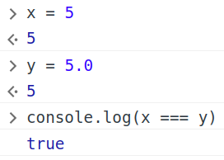
Solution
The ‘===’ checks for the equality of value of the variable and the type of the variable.

Slide 4
Problem
Is there any difference between data type of a floating point number and an integer?

Slide 5
toFixed()
Declaring Floating point value in JavaScript :-
var x = 5.7894;
console.log(x.toFixed(2));
Output: “5.78”
Returns a String value.

Slide 6
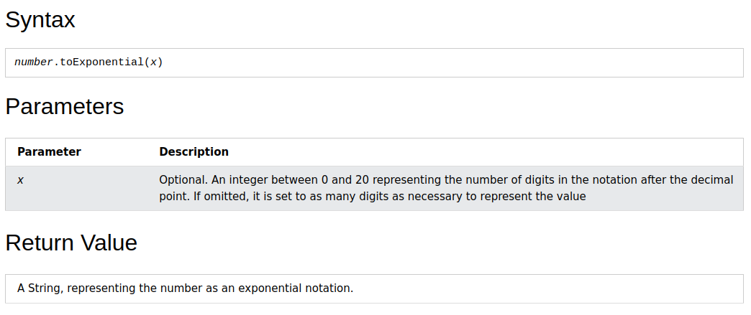
toExponential()

Slide 7
let num = 5.56789;
let n = num.toExponential(3);
Out: 5.568e+0
~~~
let num = 100
let n = num.toExponential(3);
n
'1.000e+2'

Slide 8
ParseInt() : Part 1
Parse a string and returns the first integer:
10
10
10
34
60
40
NaN
Number.parseInt("10")
Number.parseInt("10.00")
Number.parseInt("10.33")
Number.parseInt("34 45 66")
Number.parseInt(" 60 ")
Number.parseInt("40 years")
Number.parseInt("He was 40")

Slide 9
ParseInt() : Part 2
The Number.parseInt method parses a value as a string and returns the first integer.
A radix parameter specifies the number system to use:
2 = binary, 8 = octal, 10 = decimal, 16 = hexadecimal.
If radix is omitted, JavaScript assumes radix 10. If the value begins with "0x", JavaScript assumes radix 16.
Notes: If the first character cannot be converted, NaN is returned.
Leading and trailing spaces are ignored.
Only the first integer found is returned.

Slide 10
Example with radix
let s = "101"
parseInt(s, 2)
5

Slide 11
parseFloat()
Parse a string and returns the first number:
10
10
10.33
34
NaN
Number.parseFloat(10)
Number.parseFloat("10")
Number.parseFloat("10.33")
Number.parseFloat("34 45 66")
Number.parseFloat("He was 40")

Slide 12
toString()
How can we convert decimal to binary notation?
let num = 15;
let text = num.toString(2);
Convert a number to a string using base 2:
1111

Slide 13
Problem
1. Convert 11 to it’s binary representation.
2. Convert the binary ‘1101’ to it’s decimal form.

Slide 14
Solution
Convert an decimal to binary:
let num = 17;
num.toString(2);
'10001'
Convert a binary to decimal:
let x = '1101'
parseInt(x, 2)
13

Slide 15
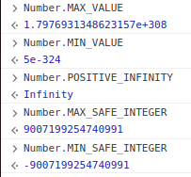
Some Constants

Slide 16
What is ‘SAFE’ in MAX_SAFE_INTEGER and MIN_SAFE_INTEGER?
Double precision floating point format only has 52 bits to represent the mantissa, so it can only safely represent integers between -(2**53 – 1) and 2**53 – 1. "Safe" in this context refers to the ability to represent integers exactly and to compare them correctly.
For example, Number.MAX_SAFE_INTEGER + 1 === Number.MAX_SAFE_INTEGER + 2 will evaluate to true, which is mathematically incorrect.
See Number.isSafeInteger() for more information.
Because MAX_SAFE_INTEGER is a static property of Number, you always use it as Number.MAX_SAFE_INTEGER, rather than as a property of a number value.

Slide 17
Problem
Can you give one use case for POSITIVE_INFINITY and NEGATIVE_INFINITY?
Answer: During overflow and underflow.
Number.MAX_VALUE + 1
1.7976931348623157e+308
Number.MAX_SAFE_INTEGER + 1 === Number.MAX_SAFE_INTEGER + 2
True (Incorrect because you cannot compare numbers outside of their safe values.)
Number.MAX_VALUE * 2
Infinity
Number.MAX_VALUE * 10
Infinity
Number.MAX_VALUE + Number.MAX_VALUE
Infinity

Slide 18
How many digits are there in the Number.MAX_VALUE?
Number.MAX_VALUE
1.7976931348623157e+308
And we saw that 100 is represented like below:
'1.000e+2'
100 has three digits and powers of 10 in it’s exponential notation is 2.
Answer:
309 Digits

Slide 19
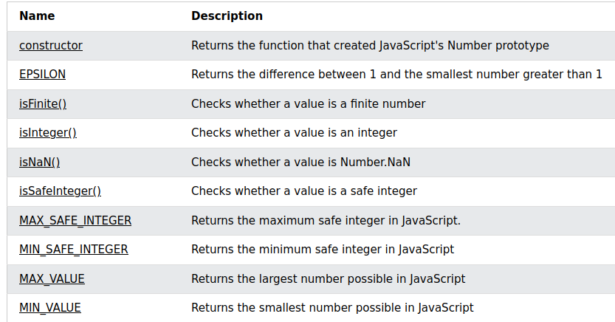
List of ‘Number’ Methods and Constants

Slide 20
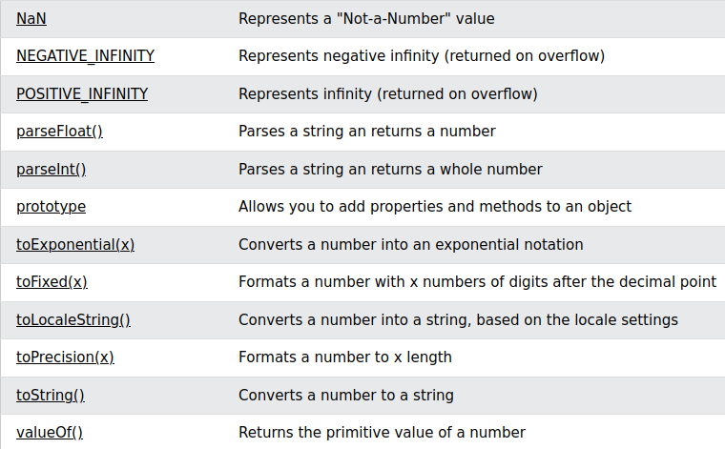

Slide 21
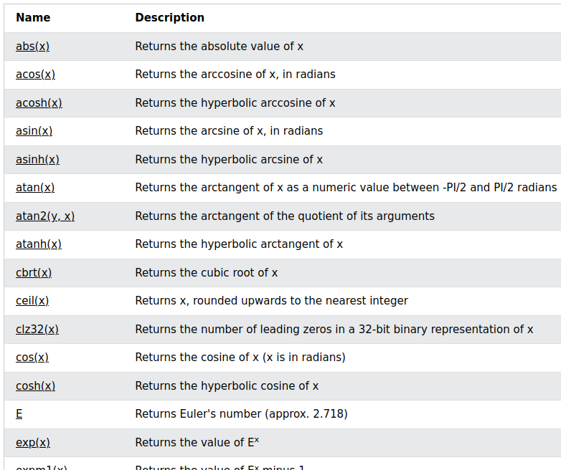
Math library of JavaScript
Ref: https://www.w3schools.com/jsref/jsref_obj_math.asp

